Slide 1


Mid Bootcamp Project - Data Analysis

Slide 2
OVERVIEW
Idea - Buy a property in Amsterdam to list on airbnb
Q1 – Which type of accommodation can return a higher profit?
Q1 – Which type of accommodation has a higher price?
Q2 – What features should I add in my property to increase the price?
Q2 – Which amenities are essential and which ones can increase the price?
Q3 – Which are the best neighbourhoods to have an airbnb?
Q3 – Information about airbnb market in Amsterdam considering neighbourhoods
Q4 – How much is the average price of a place according to some features?
Q4 – Model to predict price according to number bedrooms, type property, amenities

Slide 3
SOLUTION PROCESS
Data processing
Data cleaning
Data analysis
Model
Validation
Find Data
Questions
Buy a property in Amsterdam to list on airbnb

Slide 4
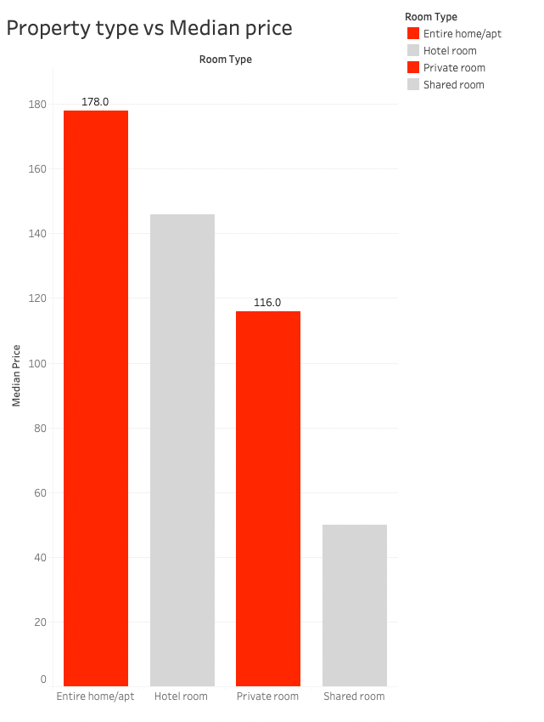
KEY FINDINGS - Q1
Q1 – Which type of accommodation can return a higher profit?
Accommodates = 2
Occupancy rate
RevPAR – Revenue per available room
Avg length of stay

Slide 5
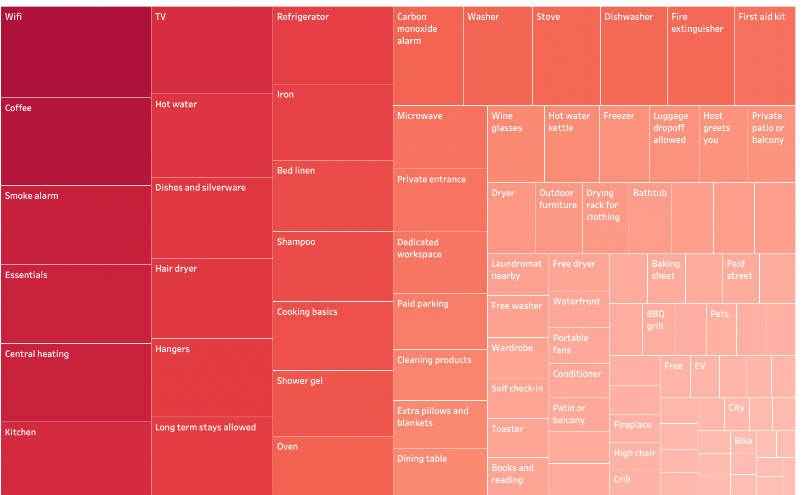
KEY FINDINGS – Q2
Q2 – What features should I add in my property to increase the price?

Slide 6
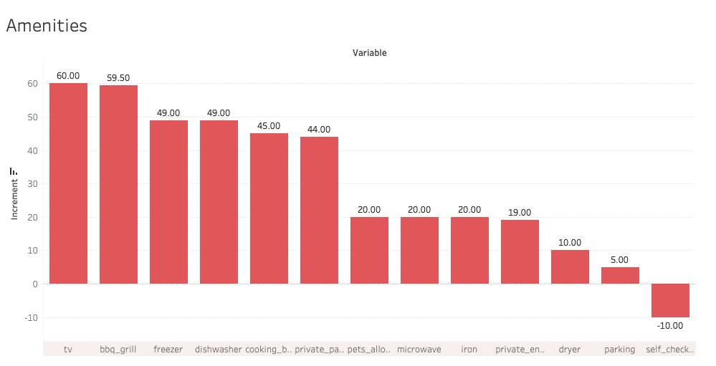
KEY FINDINGS – Q2
Q2 – What features should I add in my property to increase the price?

Slide 7
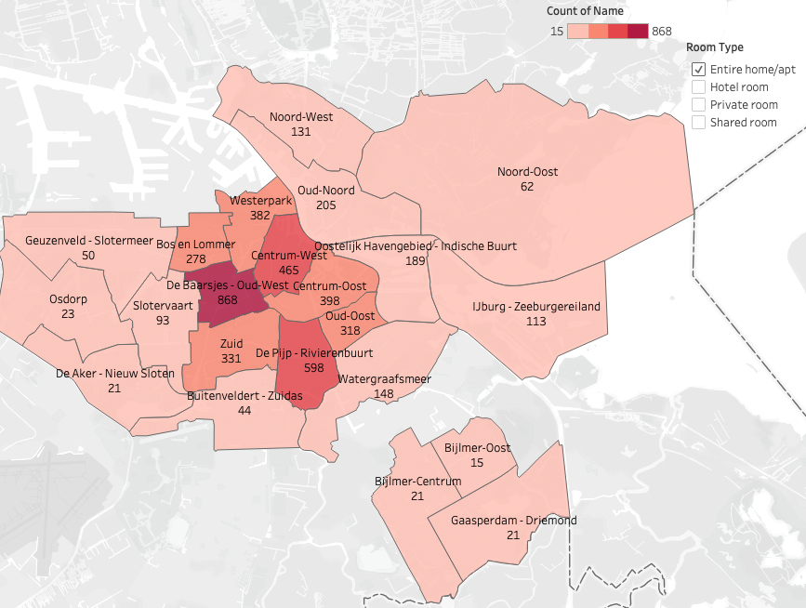
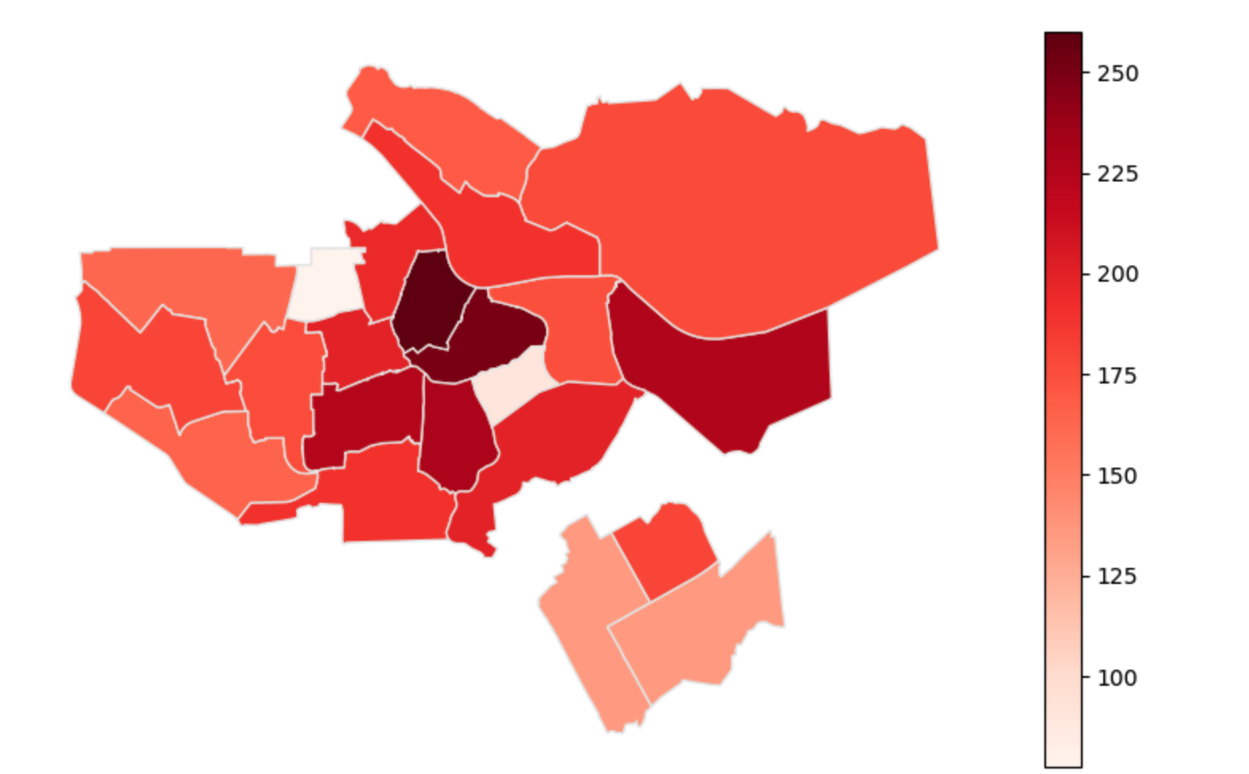
KEY FINDINGS – Q3
Property price per m2
Q3 – Which are the best neighbourhoods to have an airbnb?

Slide 8
KEY FINDINGS – Q4
Q4 – How much is the average price of a place according to some features?
Linear Regression Model
R2: 0.29
KNN Regressor
R2: 0.28
14 neighbours, uniform, p=1

Slide 9
FUTURE PROJECTS
Analyse another cities/countries and compare to Amsterdam
Predict reviews

